Slide 1
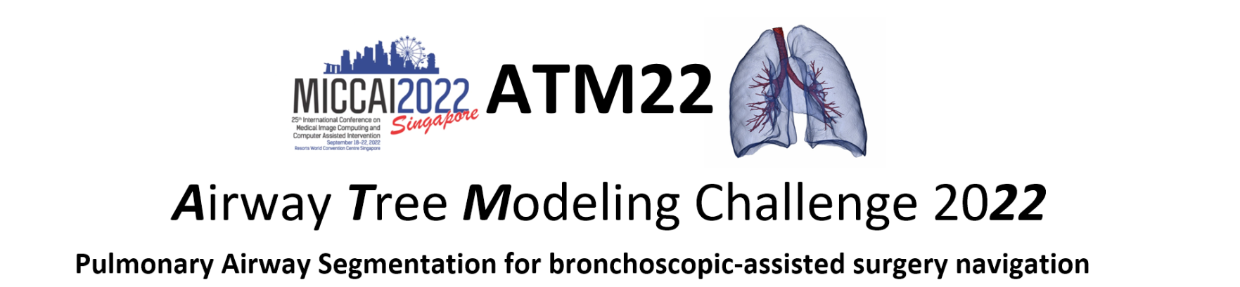
SURF22 Progress Meeting2
Group A

Slide 2
Background
Airway segmentation is a crucial step for the analysis of pulmonary diseases
Design robust algorithms to extract the airway tree structure with high topological completeness and accuracy for clinical use

Slide 3
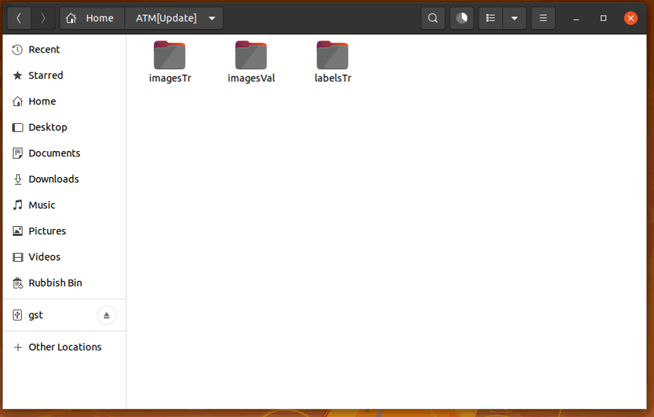
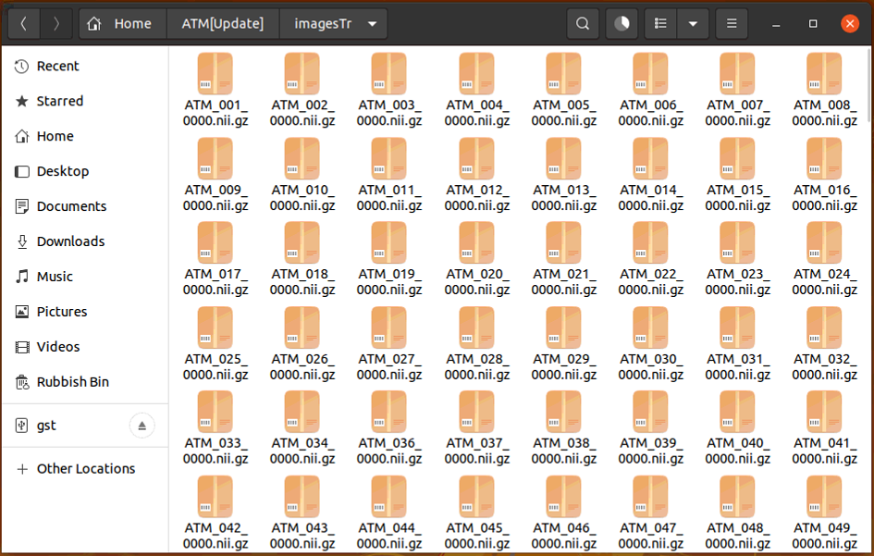
Dataset
The whole dataset contains three parts: 299+299+50

Slide 4

Data Format
There are some formats of medical image, among which DICOM and NIFTI are the most commonly used
‘nii format’ Used to store 3D or 4D image data
‘gz’--- GNUzip --- A compression program with super high compression ratio
Advantages:
Reduce the file size
Reduce data transfer time

Slide 5
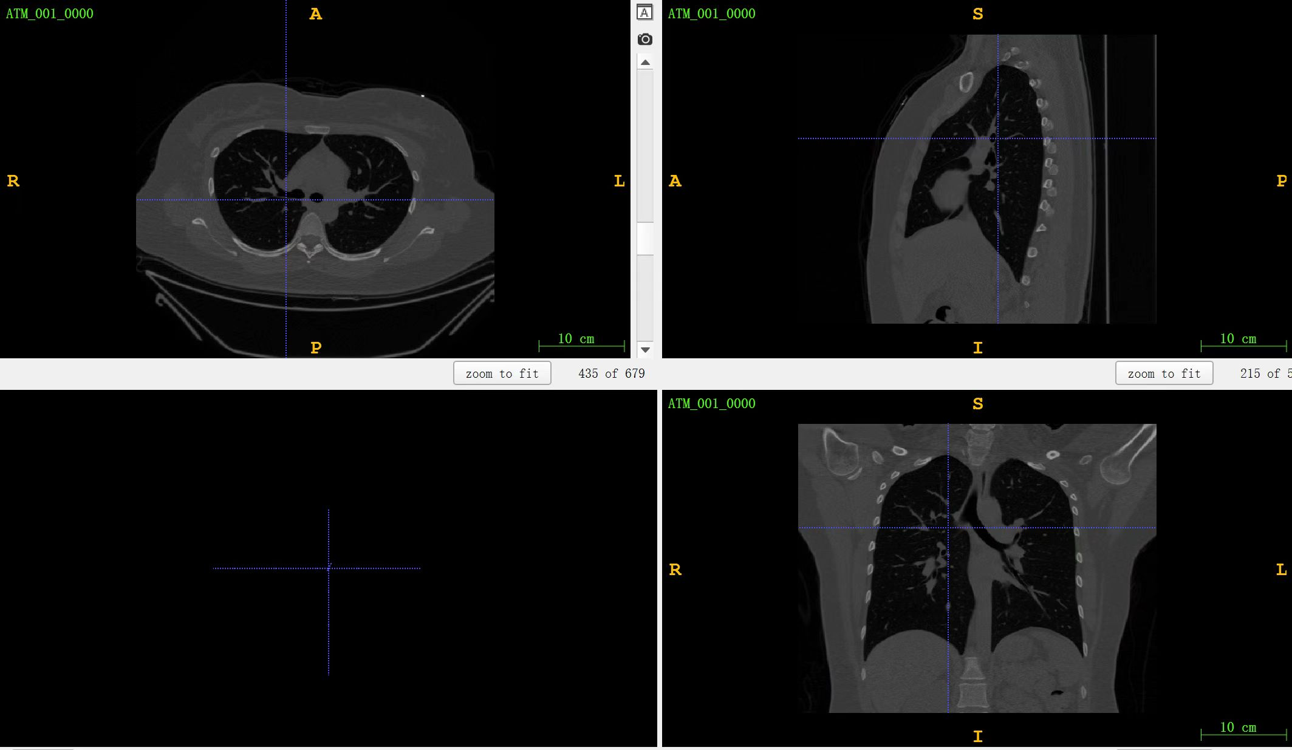
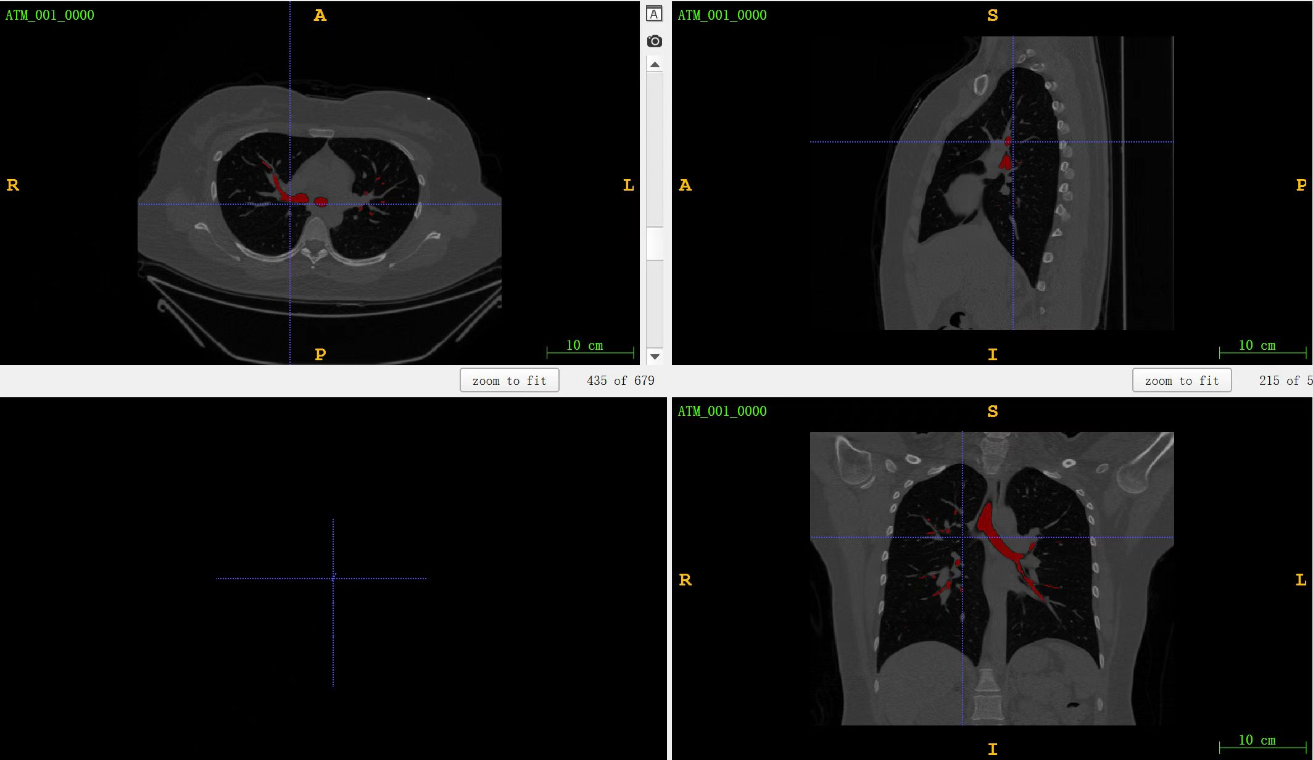
Data Overview
Image
Image merge mask

Slide 6
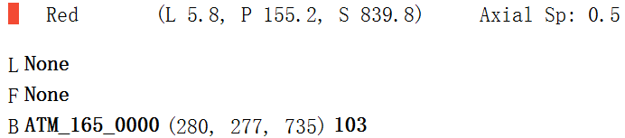
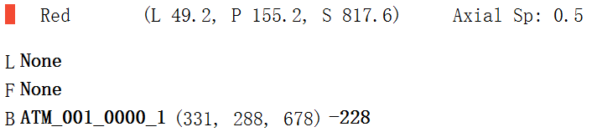
Data Preprocess (3D)
Since the length of the depth of data are not the same. Before the data entering the 3D neural network, we should make sure the data should have the same depth.
Depth is 735
Depth is 678
Strategy:
Convert the nii data into dicom format
Divide dicom data into many groups with the number of 65
Convert the dicom data into nii format
Delete all black masks and corresponding images

Slide 7
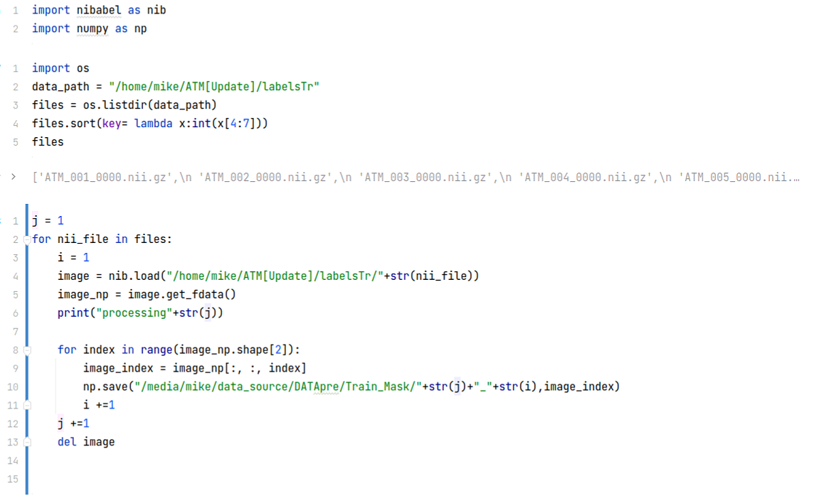
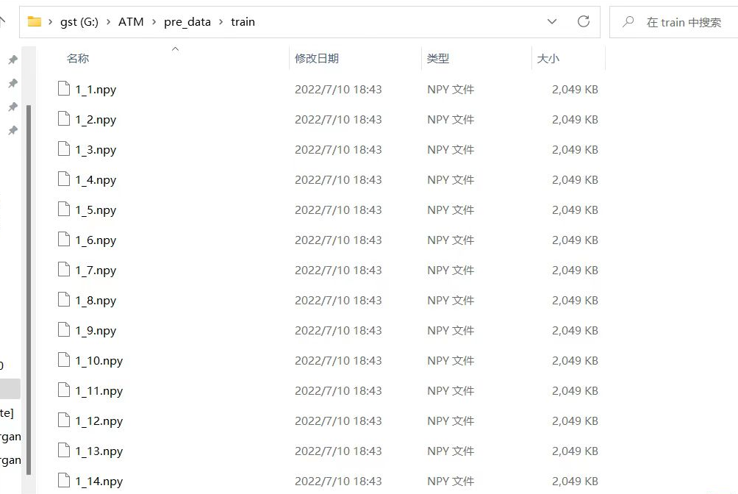
Data Preprocess (2D)
Traverse every compressed CT scans under the folder
Convert each CT scans format from ‘nii ’into ‘npy’
Cut each layer of the CT scans images(678 slices) and save them in a folder

Slide 8
Current plan
2D / 3D datasets
Current way to deal with 3D dataset will lose some information, we are exploring the new preprocess way to process 3D dataset.
Compare the effects of 2D and 3D model:
2D / 3D Attention Unet
2D / 3D Unet++

Slide 9
Thank you!

